Slide 1

Prediction of neighborhoods most likely to support multi-ethnic grocery stores
<Susan Maskery>

Slide 2

<Introduction>
Non-traditional multi-ethnic focused grocery stores are a growing segment in the grocery store industry.
Identification of prime locations for multi-ethnic grocery stores will increase the likelihood of a new market becoming profitable.
Identify urban centers with high immigrant populations. New York City has both a large immigrant population and a dense population density
Foursquare data will be used to identify a high concentration of Asian, Hispanic, or Middle Eastern restaurants as a marker for demand of Asian, Hispanic, or Middle Eastern groceries.

Slide 3
Methods
Gather longitude and latitude data for New York City neighborhoods
Limit to Brooklyn neighborhoods
Cross reference with foursquare api venue data
Separate into Asian, Central/South American, and Middle Eastern categories
Sum number of restaurants falling into each category
Run k-means analysis on restaurant data.
Identify neighborhood clusters with a relatively large number of ethnic eateries.

Slide 4
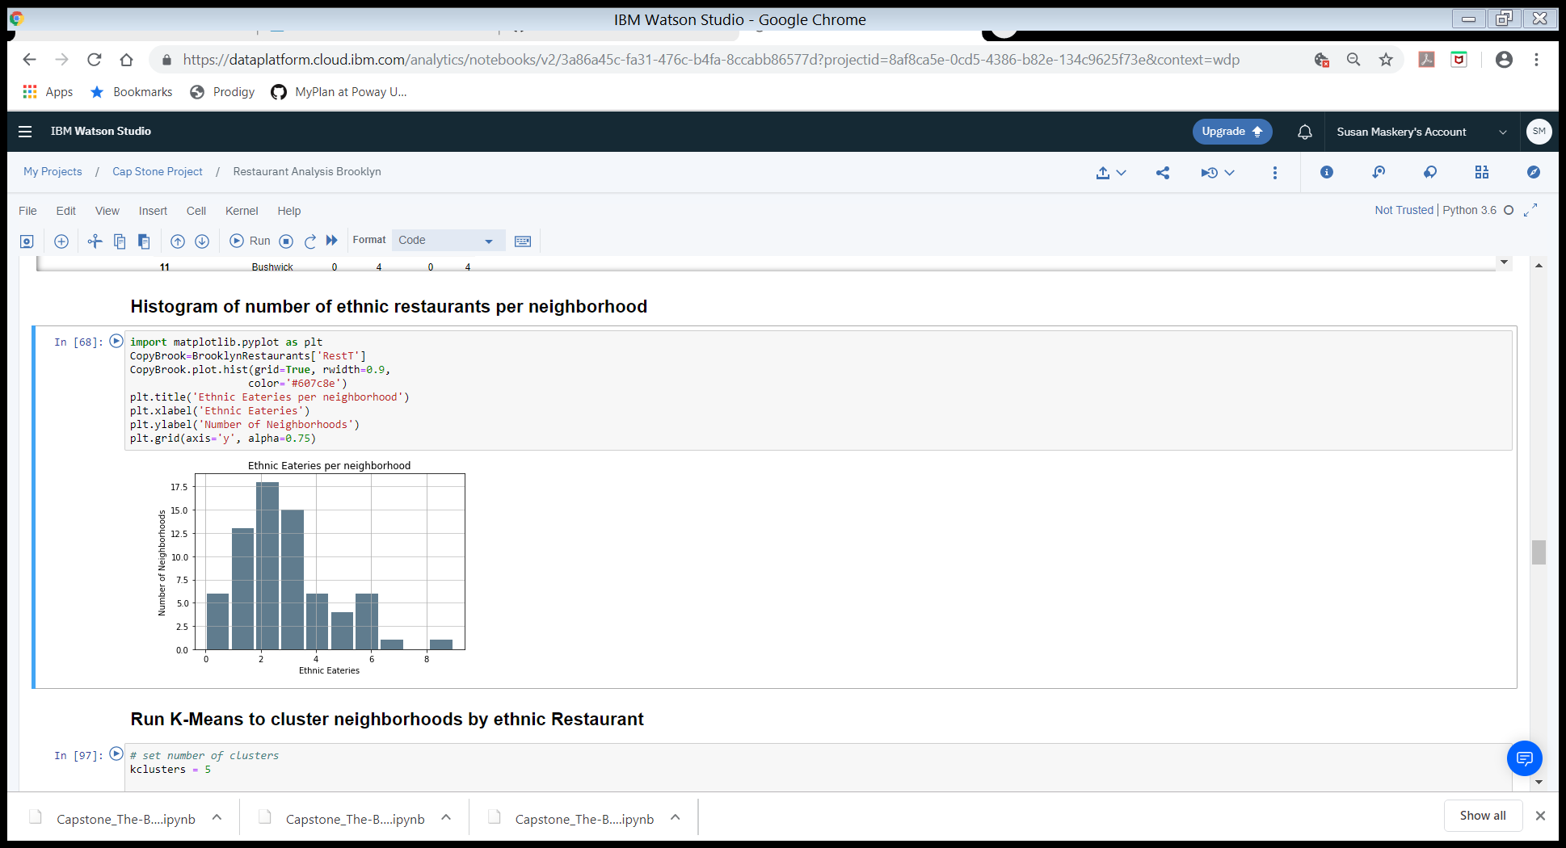
Results
Total number of restaurants per neighborhood range from 0-9
Most neighborhoods have 2 restaurants in selected categories

Slide 5
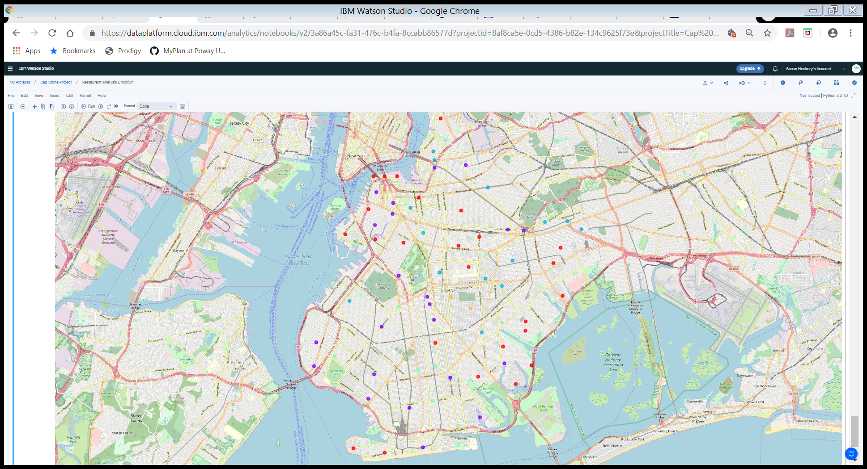
Results
Cluster overlay onto map of Brooklyn
Red dots are cluster 1
Purple dots are cluster 2
Turquoise dots are cluster 3
Green dots are cluster 4
Orange dots are cluster 5
<Insert pictures or drawings of your invention design/building process>
*you can insert a new slide for these pictures/drawings if you need to!

Slide 6
Results - Cluster Analysis
Cluster 1 – No ethnic restaurants
Cluster 2 – Mixture of ethnicities but few restaurants
Cluster 3 – Primarily Caribbean, Central and South American restaurants
Cluster 4 – Primarily Asian and Middle Eastern restaurants
Cluster 5 – Large number of Caribbean, Central and South American restaurants

Slide 7
Discussion
Identified neighborhoods in clusters 3 and 5 for Caribbean Central South American grocery stores
Identified neighborhoods in cluster 4 for Asian and Middle Easter grocery store
Future work: includes adding in demographic information like ethnicity, income, and real estate values
Future work: expand to other neighborhoods.

